Slide 1
CNN Accelerator on FPGA
AIHA-Intern-2023-NPU
Dongbeom Son / Wonbin Seo / Sumin Lee
bumin35@hanyang.ac.kr / kkyou123@hanyang.ac.kr / slbiog3025@hanyang.ac.kr
2023 aiha-intern

Slide 2
Table of Contents
CONV_ACC Design
  Overview
  Inside the conv_eng
  CONV_ACC
  IFM / WGT buffer
  Parser
  Flatter
  Read/Write master
  krnl_acc control signal
  Re arrange data
  Does the Buffer have to contain all the data?
  Hardware emulation result
Possible Improvements

Slide 3
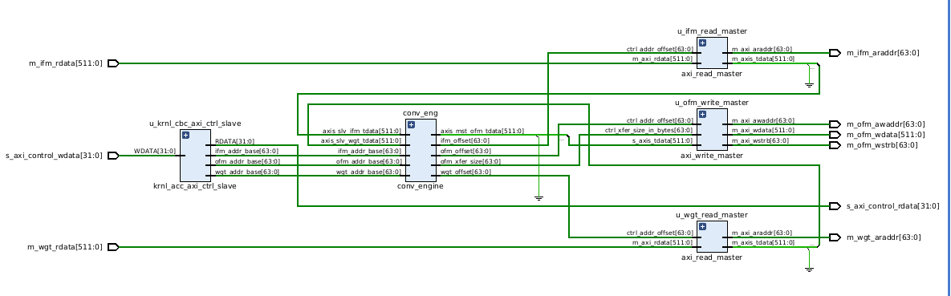
CONV_ACC Design
Overview

Slide 4
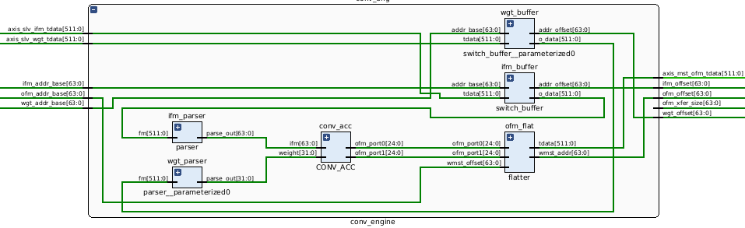
CONV_ACC Design
Inside the conv_eng
Buffer that send request to memory, receive data
Divide 512bit IFM, WGT to 64bit, 32bit respectively
Main module
Merge OFM data to 512 bit & send it to write master

Slide 5
CONV_ACC Design
CONV_ACC
  With respect to data flow, 64-bit ifm data and 32-bit wgt data for input (8 ifm, 4 wgt)
  64 bytes output for each rows, (320 bytes / tile)
PE00
PE01
PE02
PE03
PE04
WGT_0
IFM_0
PE10
PE11
PE12
PE13
PE14
WGT_1
IFM_1
PE20
PE21
PE22
PE23
PE24
WGT_2
IFM_2
PE30
PE31
PE32
PE33
PE34
WGT_3
IFM_3
IFM_4
IFM_5
IFM_6
IFM_7

Slide 6
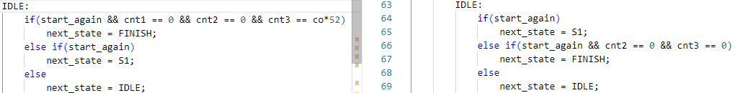
CONV_ACC Design
CONV_ACC
  With PE_FSM module, control the operation of CONV_ACC
  start_conv signal rises when all transactions are done, cfg_ci and cfg_co are sent from the host.
  ifm_read and wgt_read signals generated in conv_acc module requesting ifm and wgt input
  end_conv singal indicates all convolution for designated input and output size and channel are done
  Modify cnt3 to actual number of tiles
    (cnt1 = 19, initialize buffer for 3 cycle, process ifm and wgt for tile length(width = 16), 19 = 3 + 16)
    cnt2 = 8 = input channel #
    cnt3 = 8 * 52 = output channel # * required tile #, required tile # = 52 = 13 * 4 (5 rows / tile, 4 columns / tile, -> [61/5] , [61/16])
    , cnt1 * cnt2 * cnt3 = 19 * 8 * 8 * (4 * 13) = 63232 (total cycle)

Slide 7
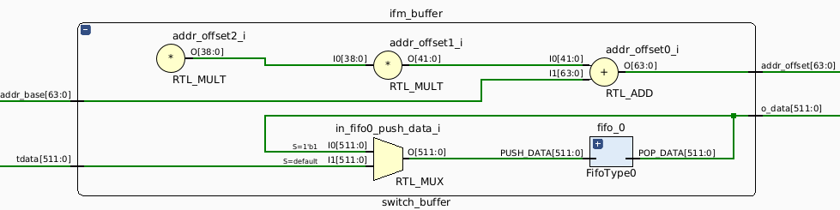
CONV_ACC Design
IFM / WGT buffer
  Using ‘rmst_req’, receive data from Global memory by 512-bit width
  Using addr_cnt to receive data sequentially (Cannot receive full data in one time)
  To provide ifm and wgt in each cycle, put all of ifm and wgt that need to operate into FIFO, then generate start signal
  Based on 8 channel input, each buffer size is 64KB to accommodate 63232 byte of ifm and 53248 byte of wgt respectively

Slide 8
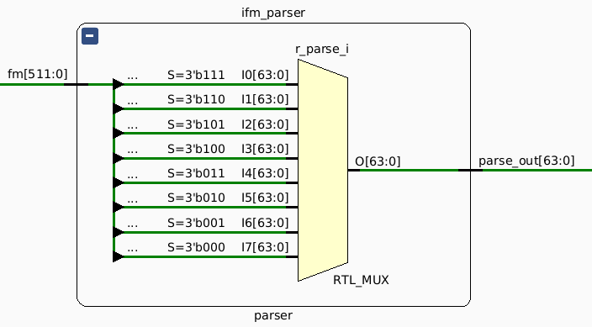
CONV_ACC Design
Parser
  In Fifo buffer, ifm and wgt stored 512bit width
  In CONV_ACC module, ifm & wgt is 64-bit, 32-bit respectively
  Divide 512-bit data to 64-bit, 32-bit and connect to CONV_ACC module

Slide 9
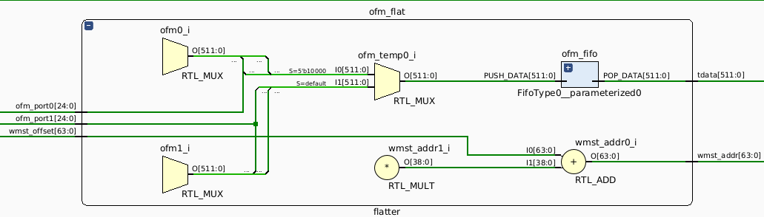
CONV_ACC Design
Flatter
  Make 32 bits by adding 7'b000_000 to the incoming ofm_port (25 bit) value
  Each output port send one row for 16 cycles, 4 bytes each
  Merge all the output to FIFO and write it to global memory using 512bit AXI write channel
  AXI write operations are performed through two bursts when more than one piece of data is stacked in the FIFO.

Slide 10
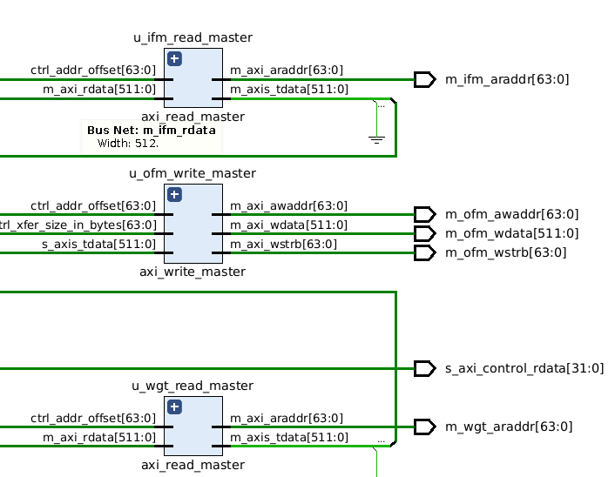
CONV_ACC Design
Read/Write master
  Using 2 Read master to receive IFM (Input Feature Map) data and WGT (Weight) data
  1 Write master to send 512-bit data to Global memory

Slide 11
CONV_ACC Design
krnl_acc control signal (Host to kernel communication by axi-lite control slave)
  Compatible with ap_chain block level control protocol, operating by ap_start, ap_continue , ap_ready, ap_idle, ap_done signals
  When both ap_start and ap_ready are asserted, reset ifm and wgt buffer
  When ifm buffer and wgt buffer are ready, asserting start_conv to start operation
  Save the output in the ofm buffer, and write the output to the global memory through the write master when more than one output is stacked

Slide 12
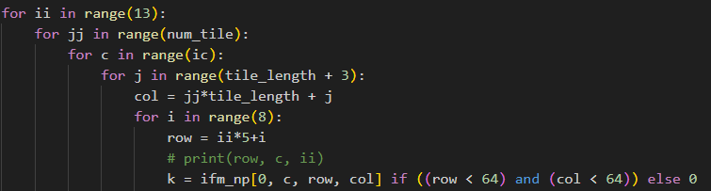
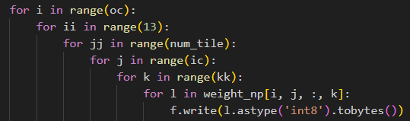
CONV_ACC Design
Re arrange data
  Data order needs to be rearranged for sequential use of data
  Resolving the problem of redundant use of rearranged data will reduce the buffer size
Tile # rows = [64/5] = 13
Tile # colums = 64/16 = 4
Tile_length + (kernel_size – 1) = 19
Total rearrange input size = 63232
Input size before rearrange = 64*64*8 = 32768
kk = kernel size (4)
Total rearranged weight size = 53248
Weight size before rearrange = 4*4*8*8= 1024

Slide 13
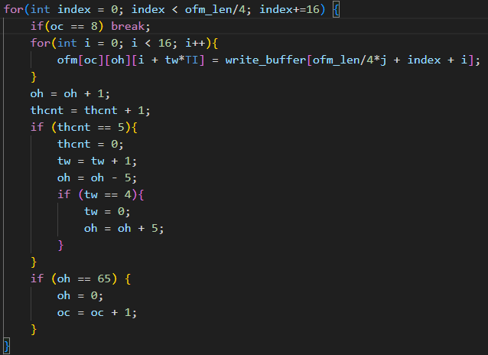
CONV_ACC Design
Re arrange data
  Also, output data need to be rearranged
  The output size of the kernel is 133,120 byte
  = (# of tile * # of output channel * output / tile * 4 byte
  = 52 * 8 * 16 * 5 * 4 = 133,120
  Actual output data is 61 * 61 * 8 * 4 = 119,072
  (output height * output width * output channel * 4 byte)

Slide 14
CONV_ACC Design
Does the Buffer have to contain all the data?
  Kernel’s data requirement - ifm : 8 byte / cycle = 2.4Gb/s (for 300Mhz)
  Kernel’s output - ofm : 320 byte / 19*8 cycle = 631Mb/s
  All less than the bandwidth of the AXI interface
  Designing with Global memory -> small buffer -> kernel will reduce buffer size

Slide 15
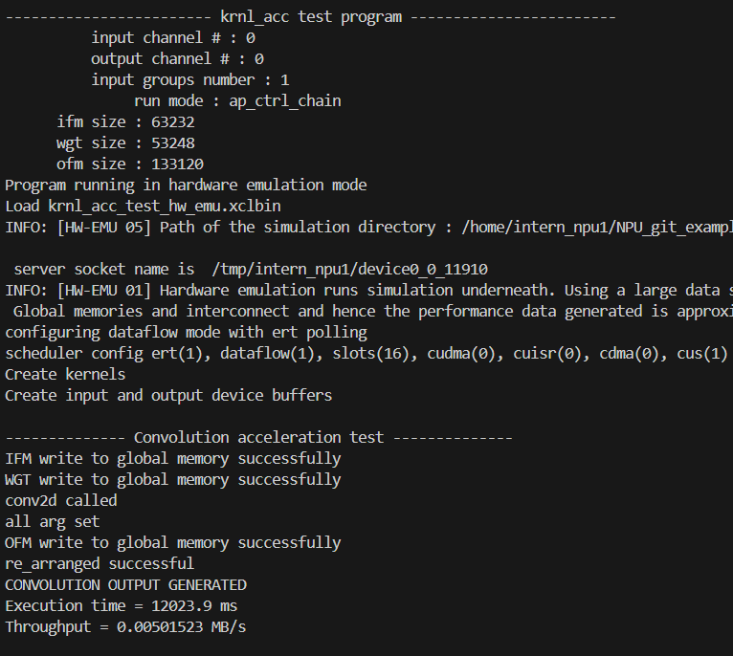
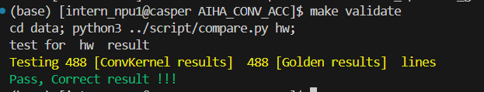
CONV_ACC Design
Hardware emulation result
                Validate results

Slide 16
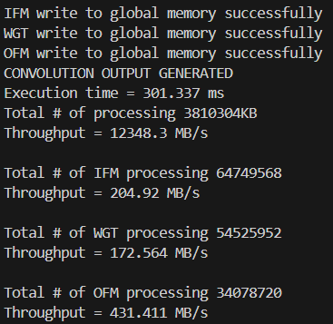
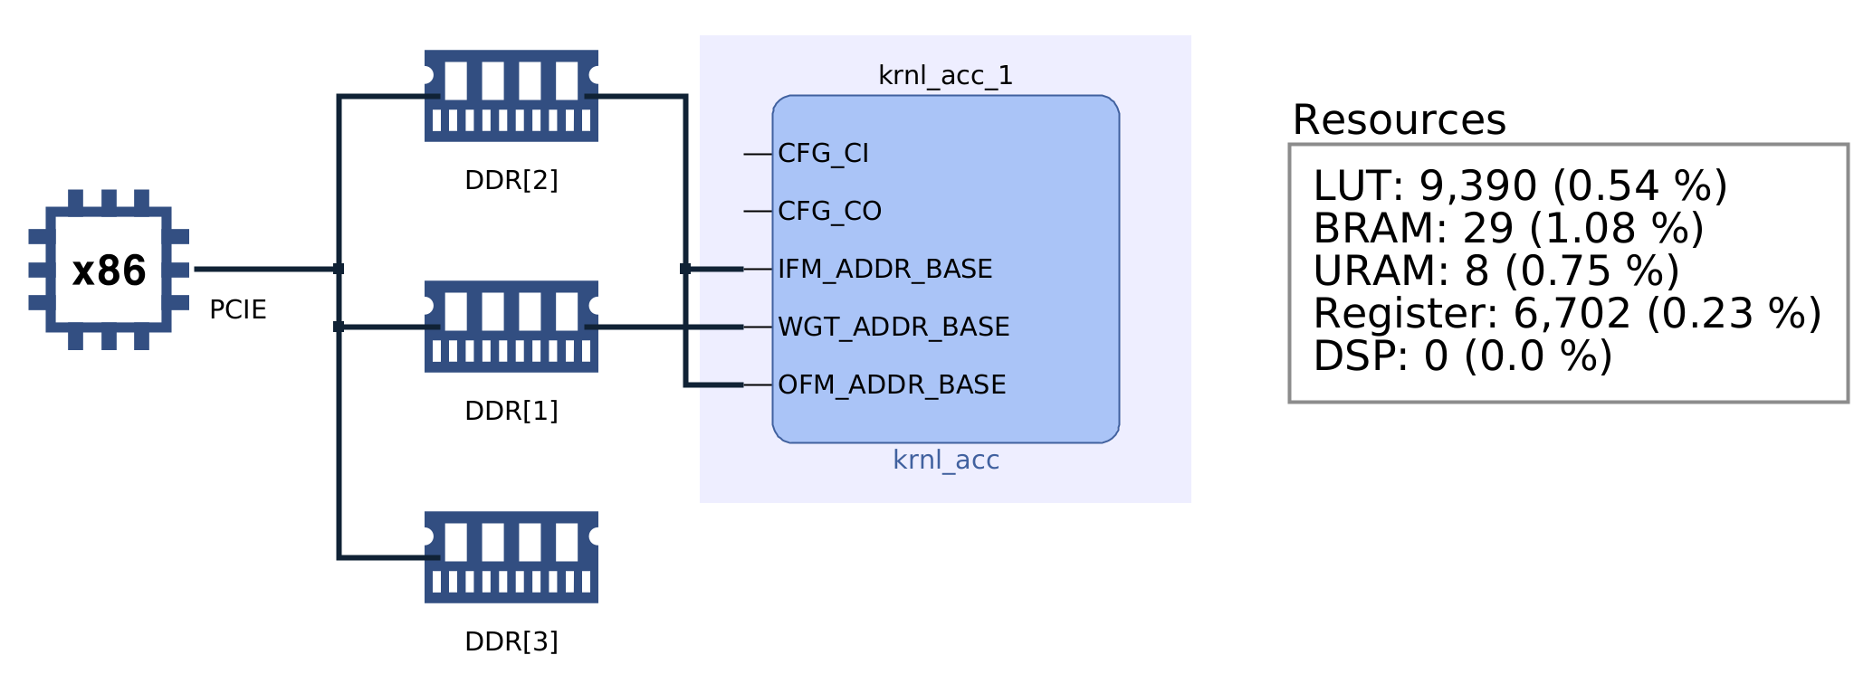
CONV_ACC Design
Result
Total # of precessing / group : 61 * 61 * 16 * 8 * 8 = 3721 KB
Group # : 1024
Execution time = 304.233 ms (1024 group)
Throughput = 12230.8 MB/s

Slide 17
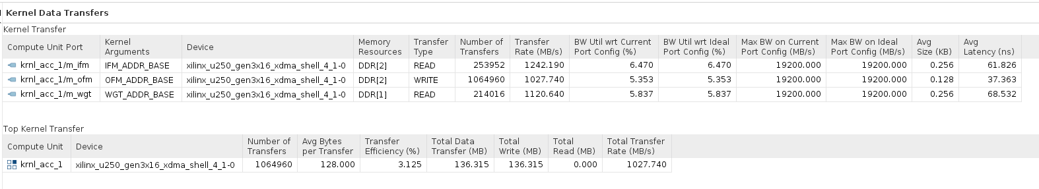
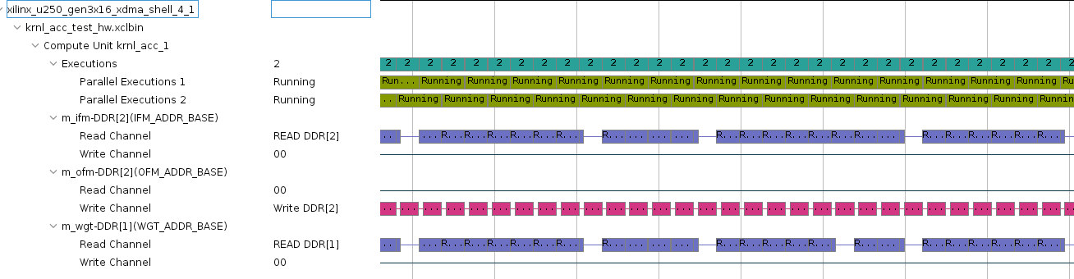
CONV_ACC Design
Result

Slide 18
Possible improvements
Reducing buffer size
  Throuput of kernel is relatively small so kernel operation can be done by much smaller buffer size
DSP utilization
  DSP modules could be used to combine the currently pipelined multiplication steps into one step.
Increase clock speed
  It may be possible to change the clock, which is currently 300Mhz, to 500MHz through the clock converter
Optimizing tiling to reduce overhead
  Tile size and ifm/ofm size are not optimized and many meaningless calculations are done
  Tile length, number of pe arrays, ifm/ofm size might be optimized

